Slide 1
College Management System
-----------------------------------------------------------------------------------------------

Slide 2
Group (M5) :
01. Piyush Singh
02. Ayush Padhi
03. Snehal Harsh
04.Priya Khetan
05.Nilesh Kumar
06.Suchismita Dhalsamanta
07.Anurag Thakur
08.Ananya Dash
09.Neeraj Kumar Singh
10.Rishabh Raj
11.Aniket Kumar
12.Yuktamukhi Mohapatra
13.Aniket Kumar

Slide 3
Synopsis
The purpose of this system is to equipment's automate the existing manual system by the help of computerized and full-fledged computer software, fulfilling their requirements, so that their valuable data can be stored for a longer period with easy accessing and manipulation of the same. The required hardware and software are easily available and easy to work with.
College Management system, as described above, can lead to error free, secure, reliable and fast management system. It can assist the user to concentrate on their other activities rather to concentrate on record keeping. Thus it will help organization in better utilization of resources. The organization can maintain computerized records without redundant entries. That means that one need not be distracted by information that is not relevant, while being able to reach the information.
Basically, the project describes how to manage foe good performance and better services for the users.

Slide 4
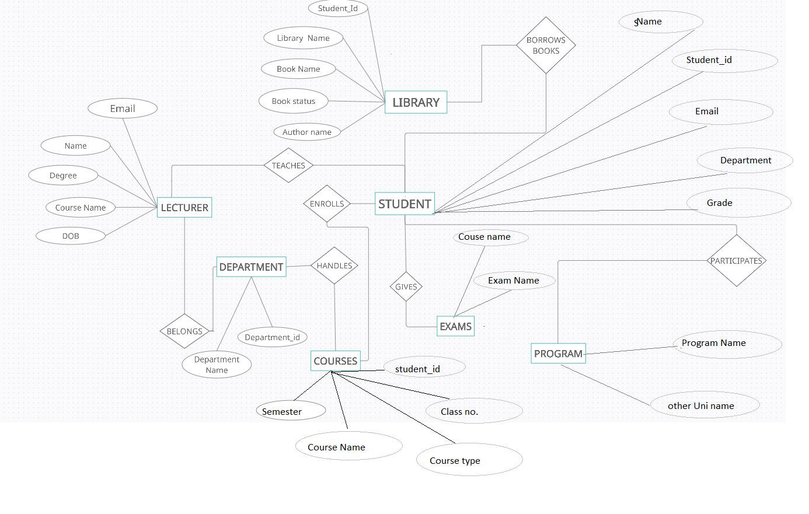

Slide 5
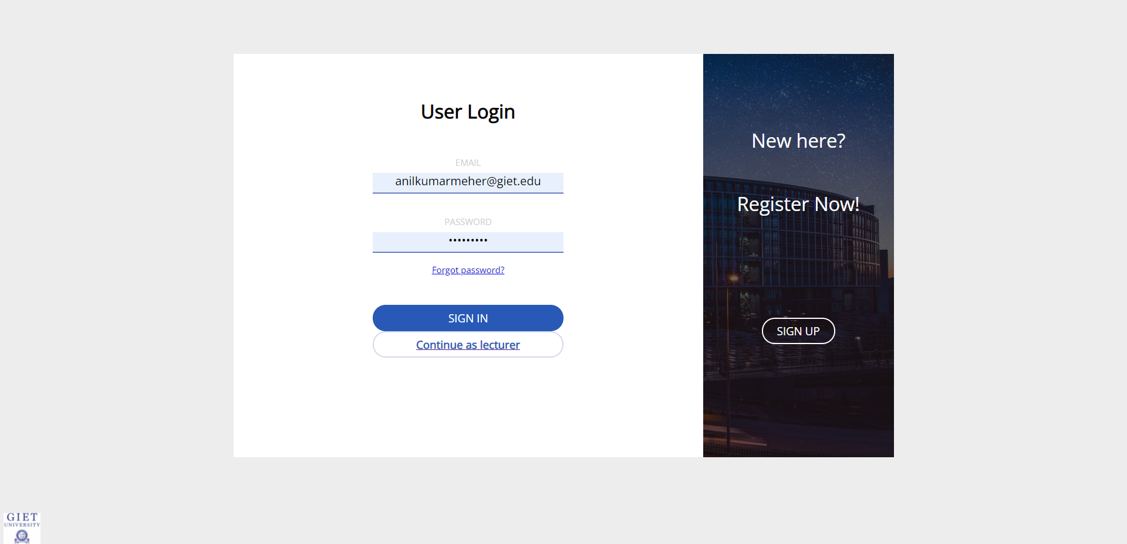
This is the login page . New users will have to signup while the existing users can sign in through their user_id and password .Both student and lecturer can sign in through their respective id.

Slide 6
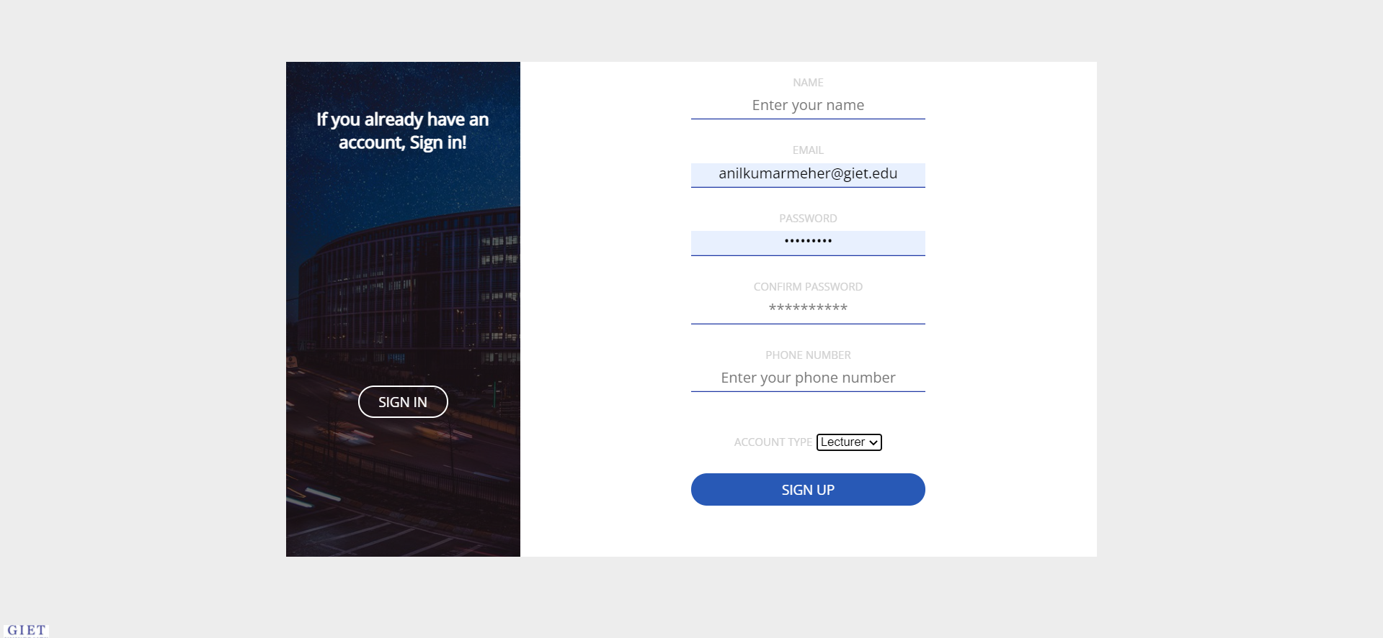
This is the sign up page for the new users. New students and faculty members can sign up by entering the required details.

Slide 7
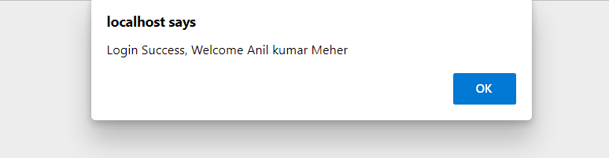
The user receives a pop up message once he/she is successfully login .

Slide 8
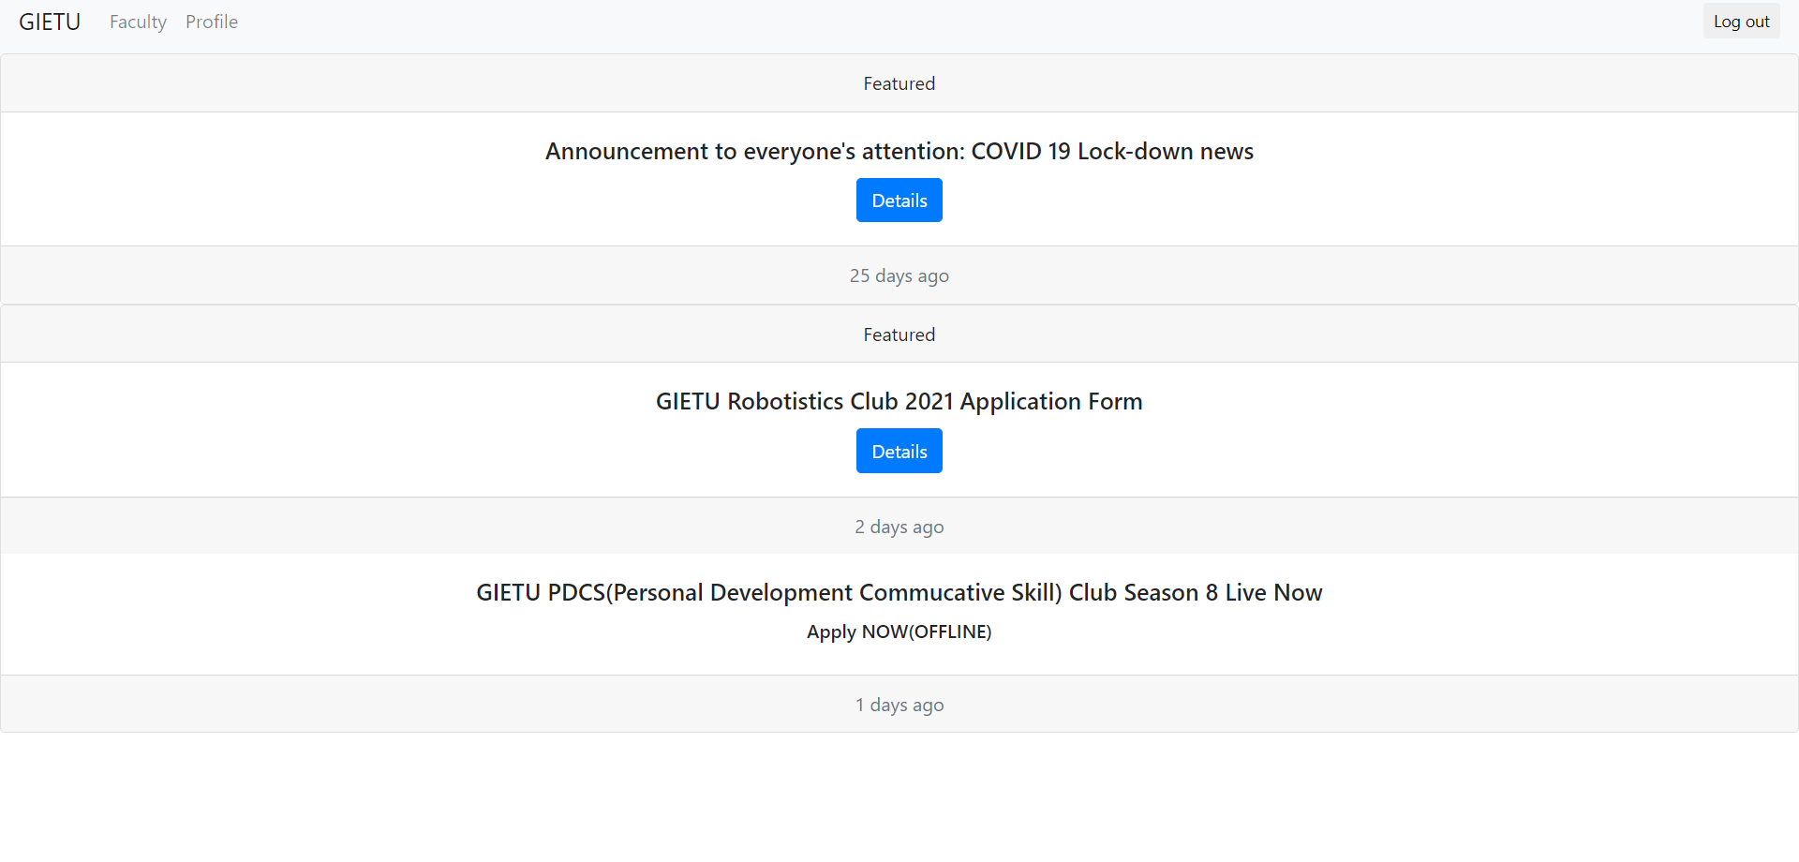
When the user sign in as lecturer, he/she is taken to this page, where the above mentioned details are retrieved. We have linked the news page to the live server for fetching latest updates .

Slide 9
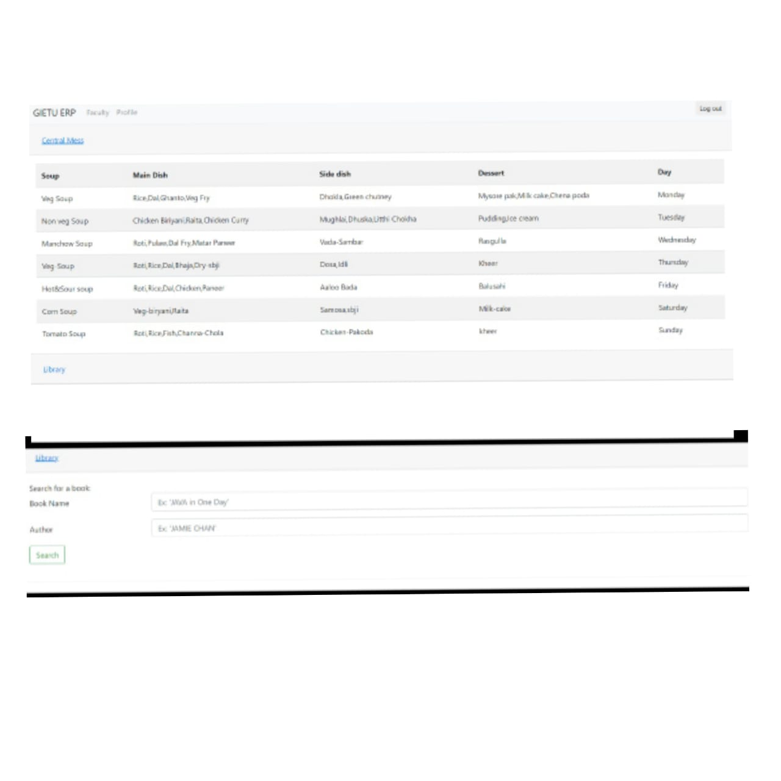
This page provides the info regarding the updated menu and the availability and non-availability of books in the library for the faculty.

Slide 10
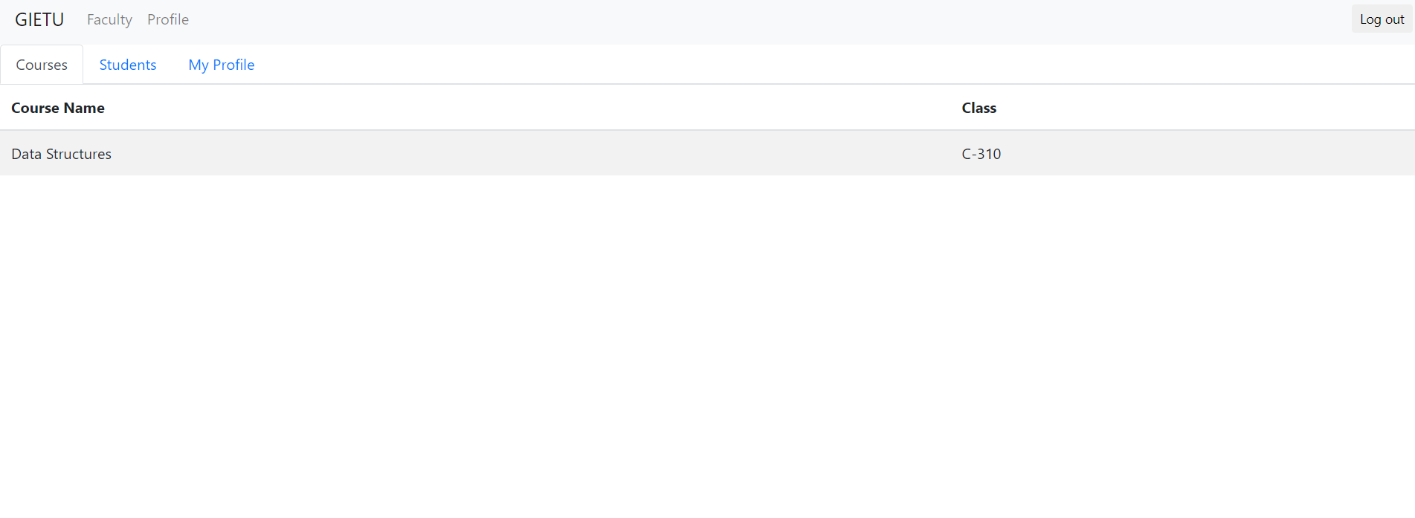
This page provides the info of the course for which the faculty is assigned.

Slide 11
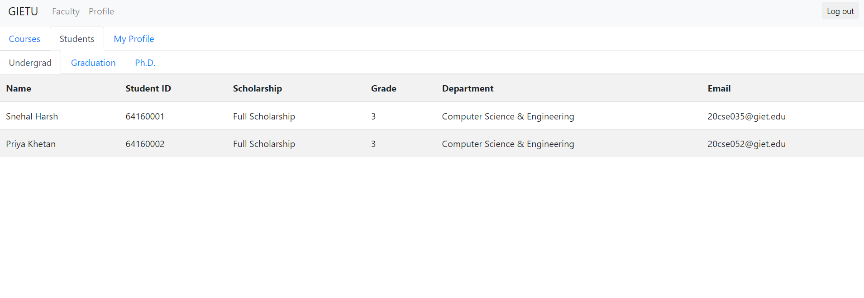
This page gives the detailed info of the students , the faculty is assigned with.

Slide 12
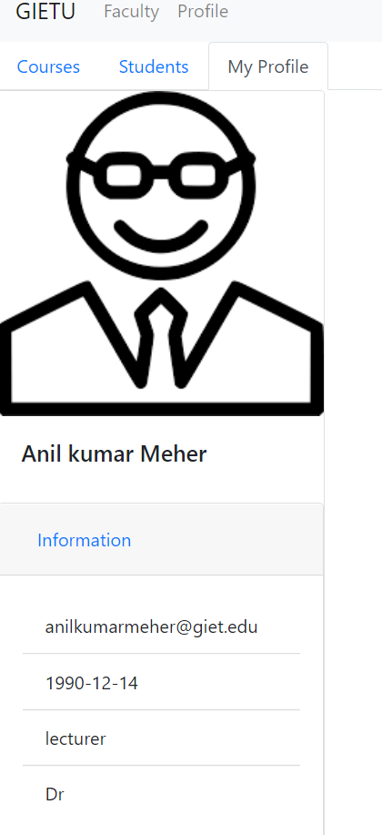
This page shows the profile of the faculty .

Slide 13
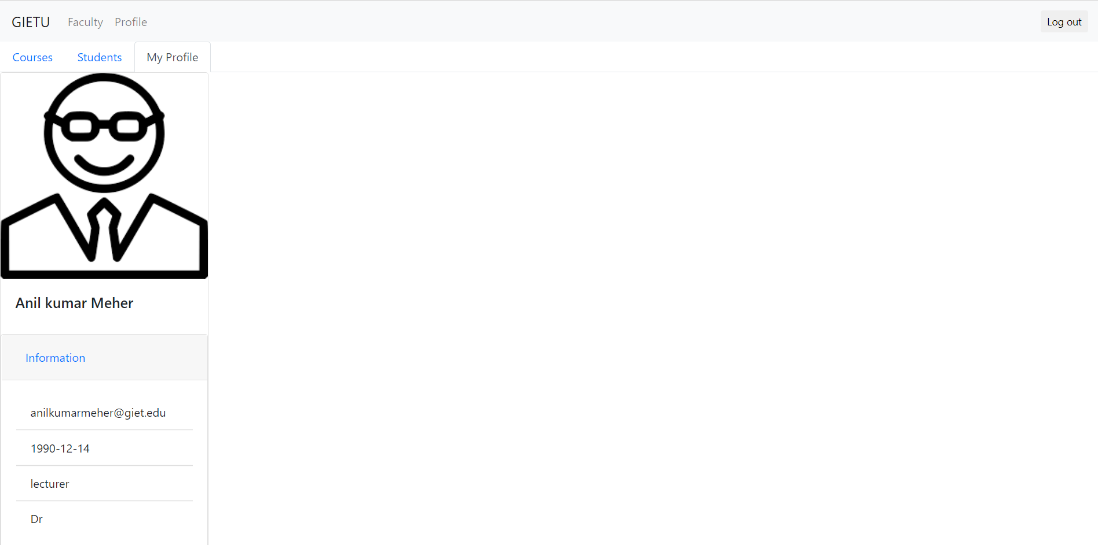
There’s also log out option available at the top right corner of the page .

Slide 14
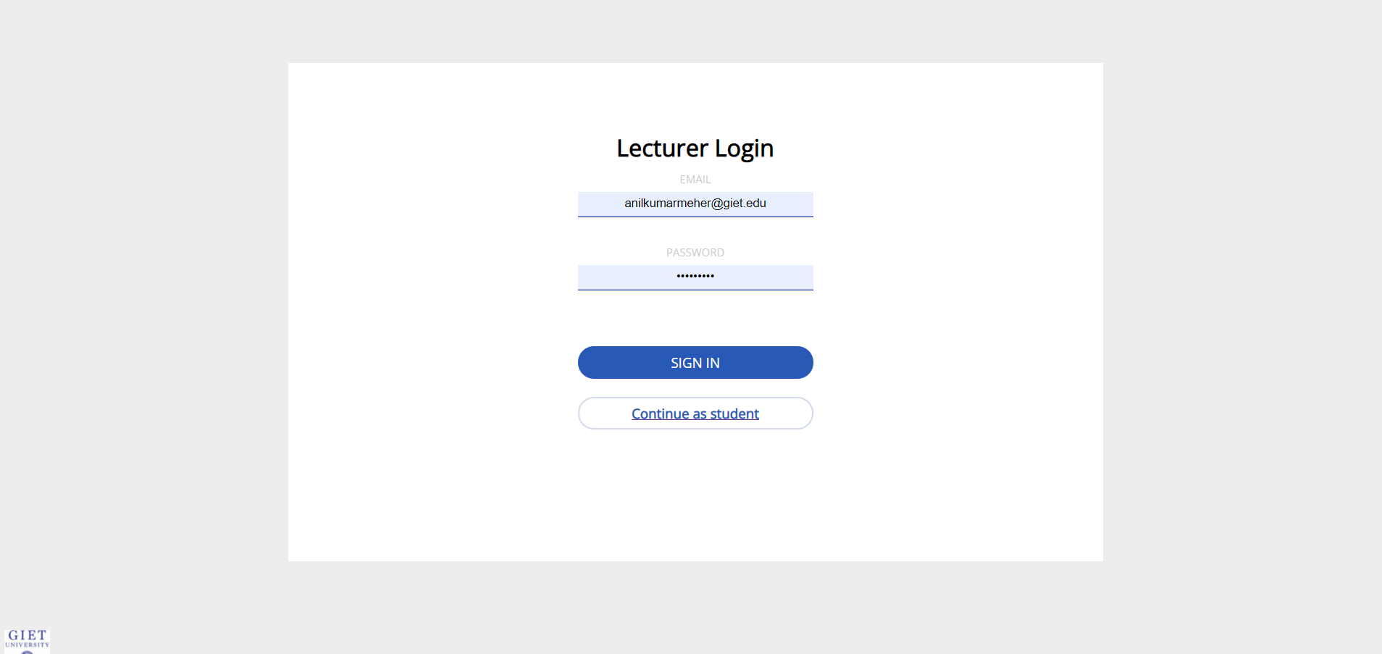
When the user is a student, he/she can continue as student and log in .

Slide 15
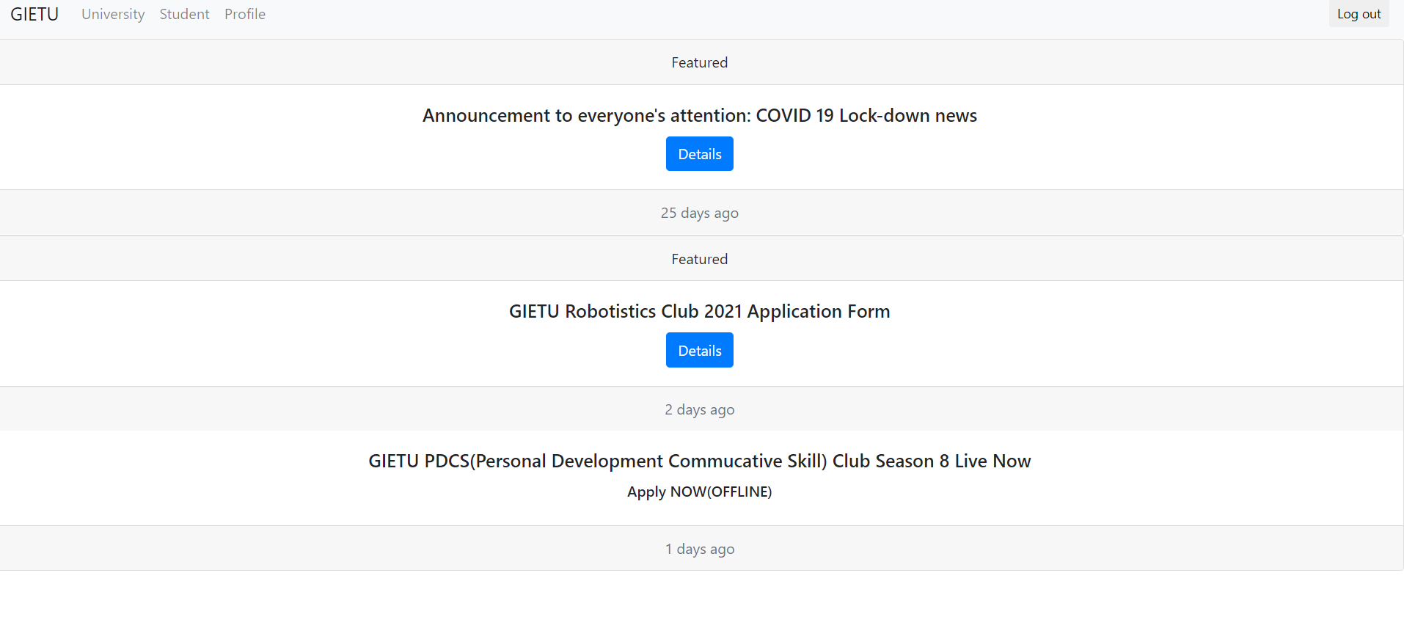
This is the home page for the user login as student, where the above mentioned details are retrieved. We have linked the news page to the live server for fetching latest updates.

Slide 16
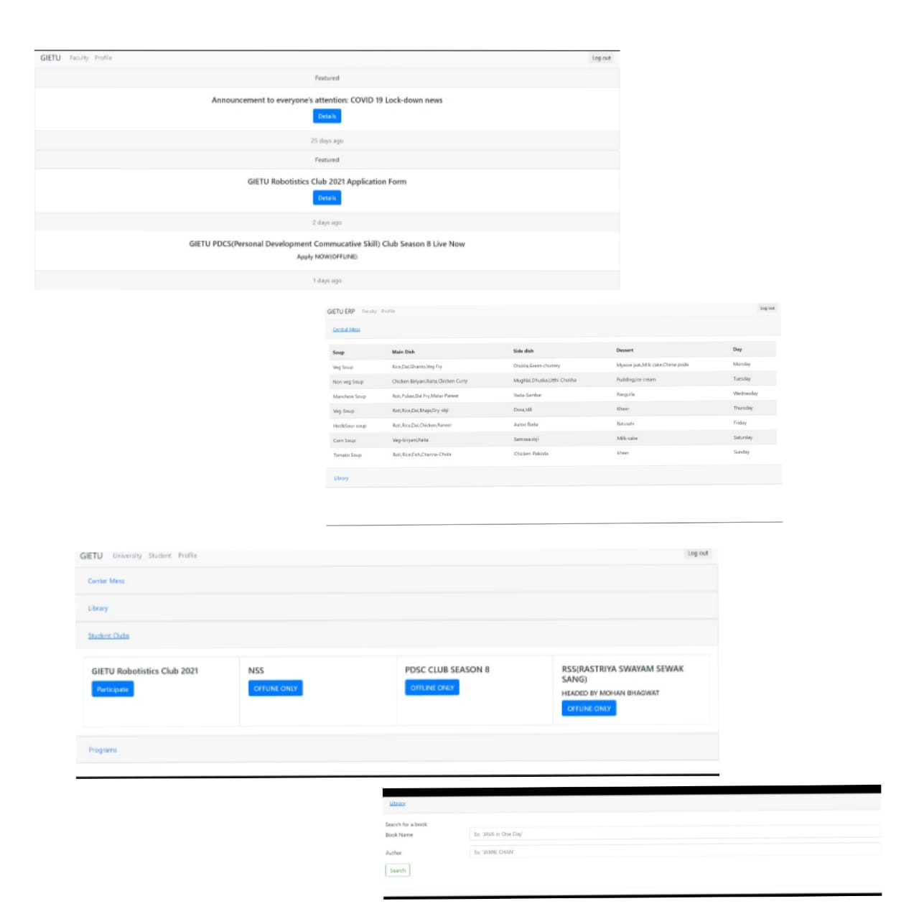
This page provides the info regarding the updated menu and the availability and non-availability of books in the library for the student. The user is also updated regarding different events .

Slide 17
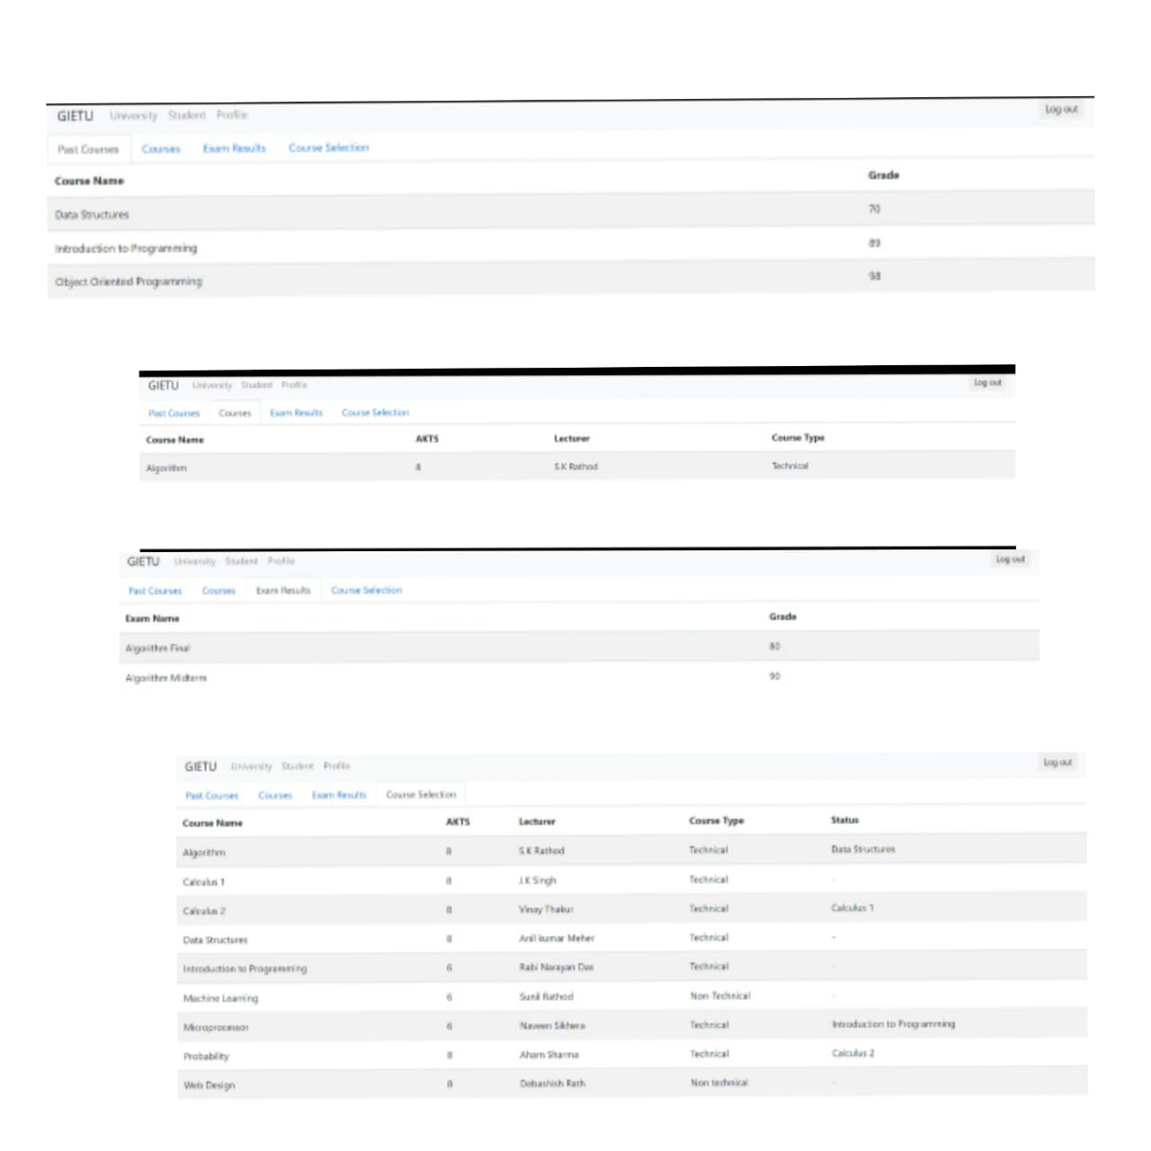
This page provides the info regarding the courses and the results of the students.

Slide 18
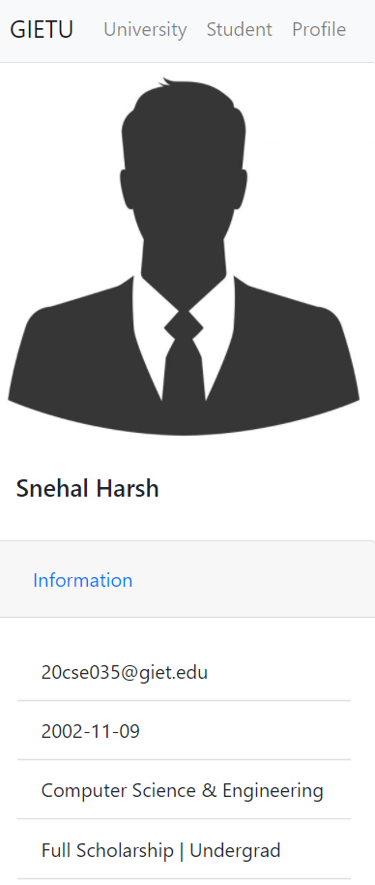
This is the profile page of the student.

Slide 19
THANK YOU

